Slide 1
Lecture 7
Reinforcement Learning
Most material from Fei Fei Li’s Course at Standford University

Slide 2
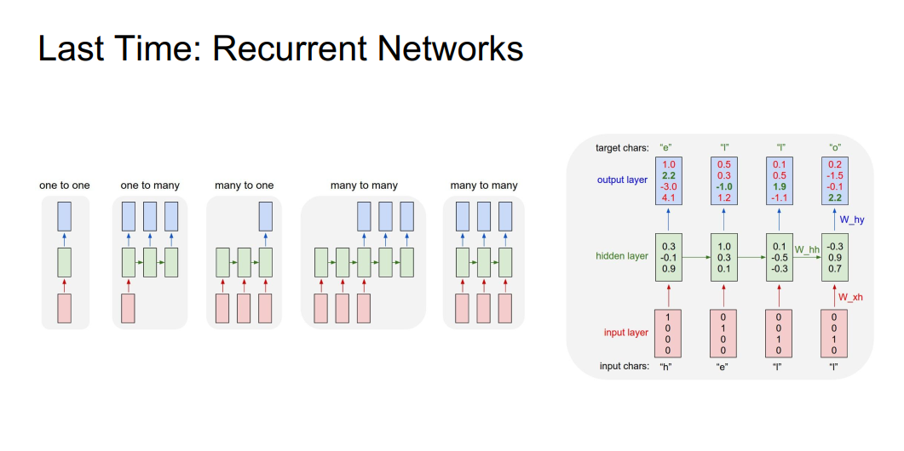

Slide 3
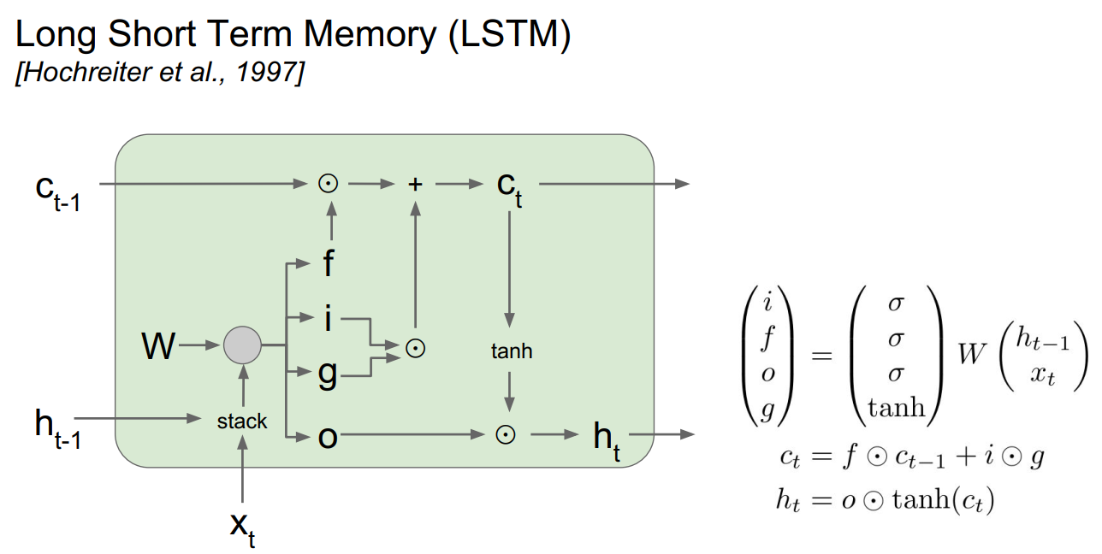
Last Time: LSTM

Slide 4
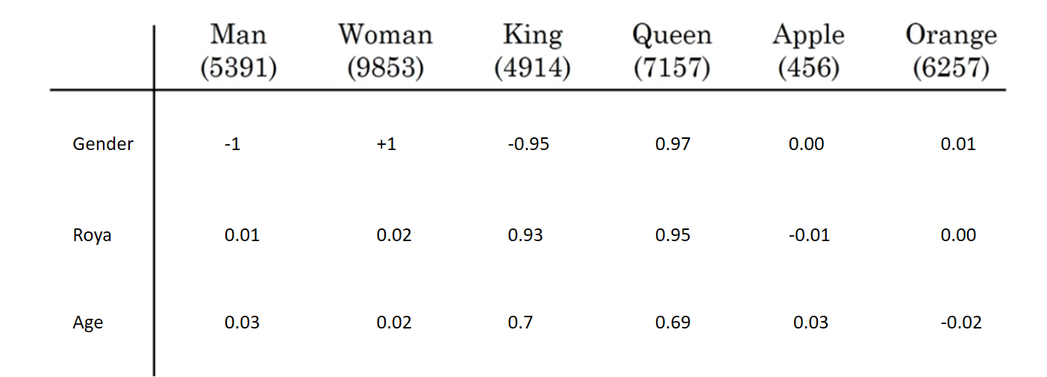
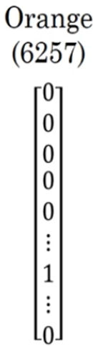
Last Time: Embedding matrix
*

Slide 5
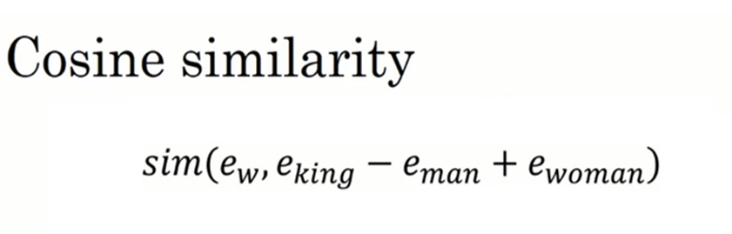
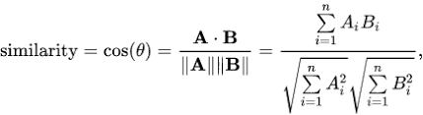
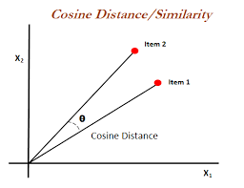
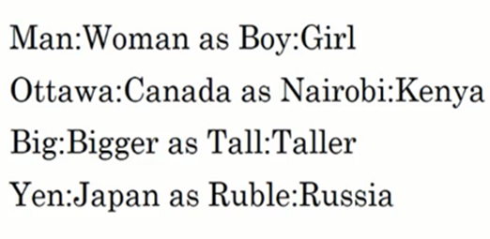
Last Time: Cosine similarity

Slide 6
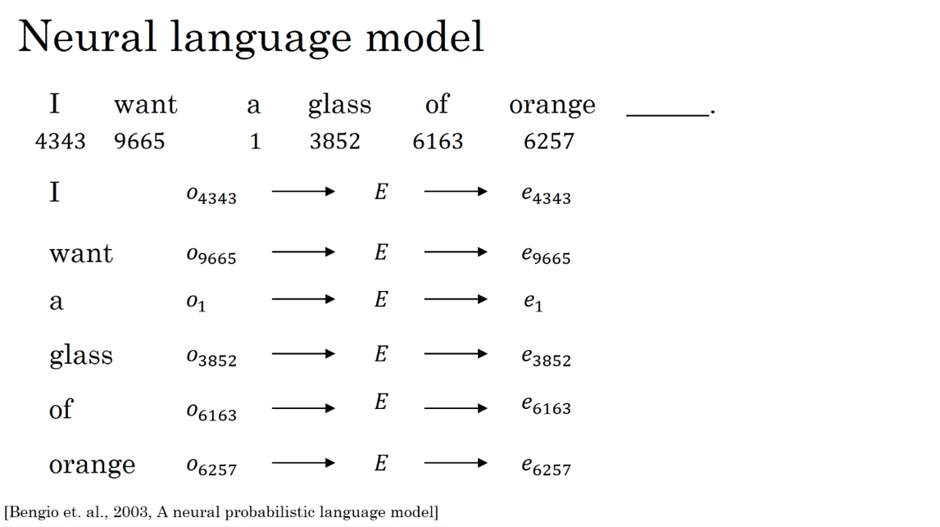
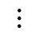
Last Time: Neural Language Model
$$⋮$$
Softmax

Slide 7
Today
Word2Vec
Glove
Image Captioning
Reinforcement Learning

Slide 8
Word2Vec

Slide 9
Word2Vec
Approach to represent the meaning of word
Represent each word with a low-dimensional vector
Word similarity = vector similarity
Key idea: Predict surrounding words of every word
Faster and can easily incorporate a new sentence/document or add a word to the vocabulary

Slide 10
Word2Vec
2 basic models:
Continuous Bag of Word (CBOW): use a window of word to predict the middle word
Skip-gram (SG): use a word to predict the surrounding ones in window.

Slide 11
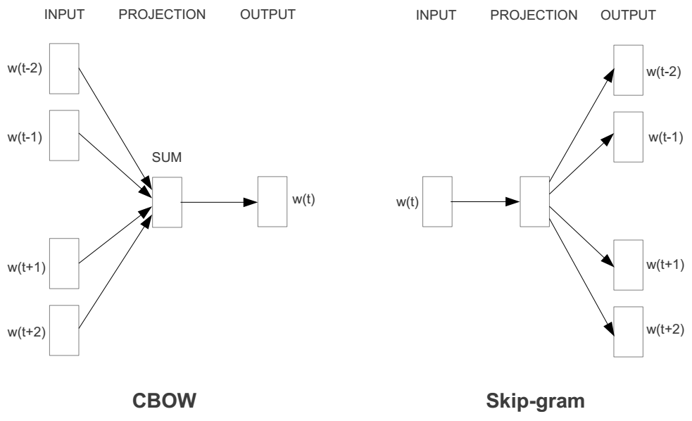

Slide 12
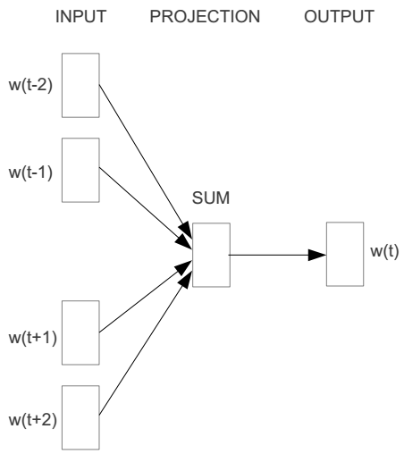
Word2vec – Continuous Bag of Word
E.g. “The cat sat on floor”
Window size = 2
the
cat
sat
on
floor

Slide 13
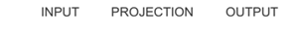
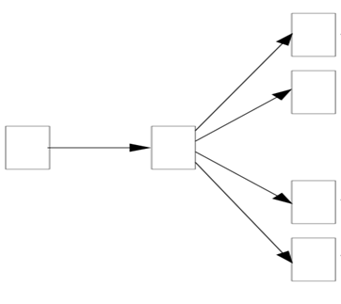
Word2vec – Skip-Gram
E.g. “The cat sat on floor”
Window size = 2
the
cat
sat
on
floor

Slide 14
Glove

Slide 15
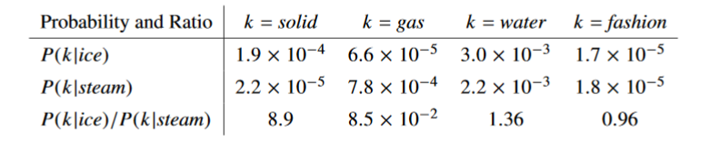
Global Vectors for Word Representation (GloVe)
Uses ratios of co-occurrence probabilities, rather than the co-occurrence probabilities themselves

Slide 16
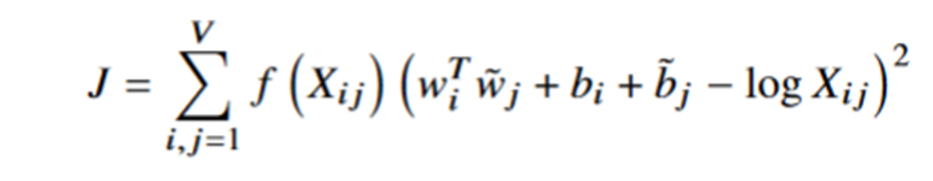
GloVe

Slide 17
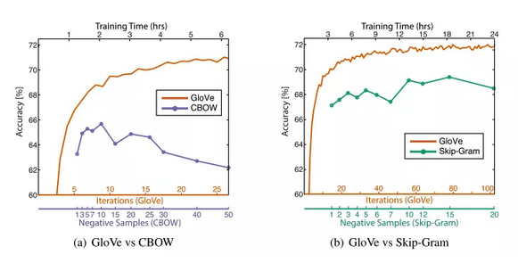
GloVe

Slide 18
Image Captioning

Slide 19
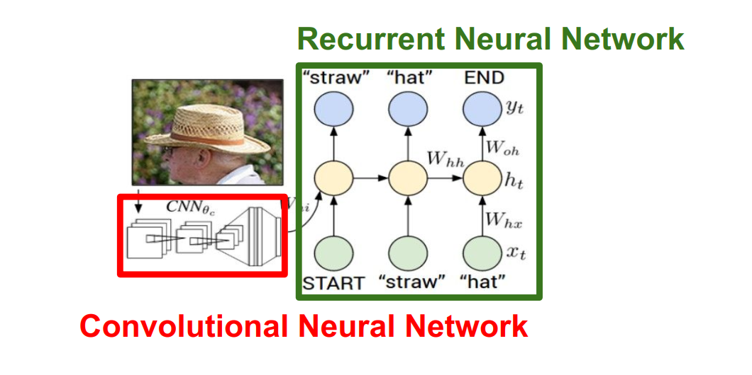
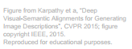

Slide 20
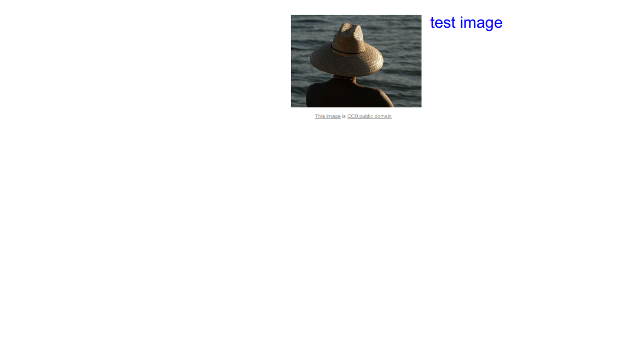

Slide 21
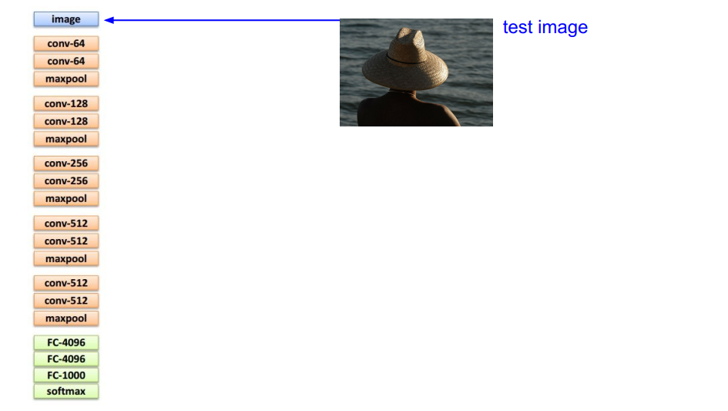

Slide 22
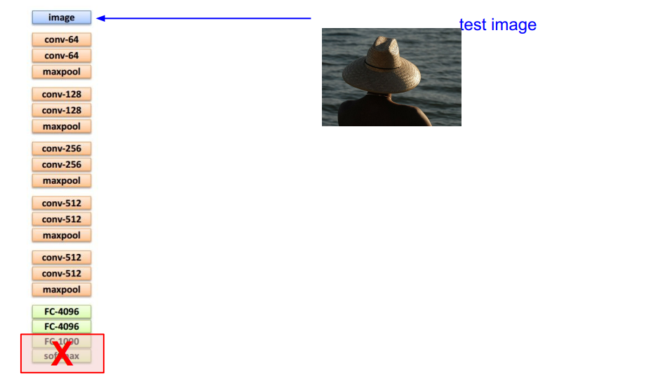

Slide 23
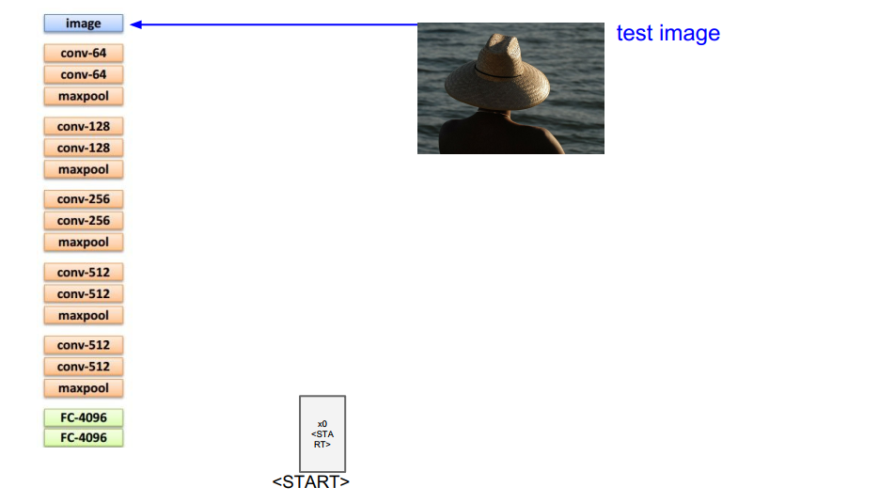

Slide 24
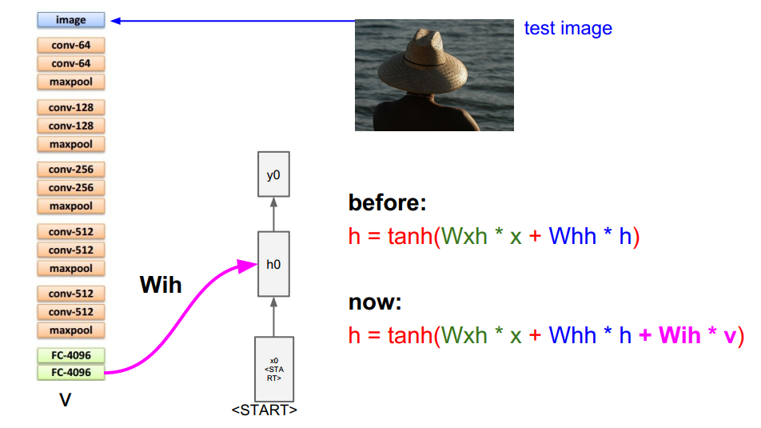

Slide 25
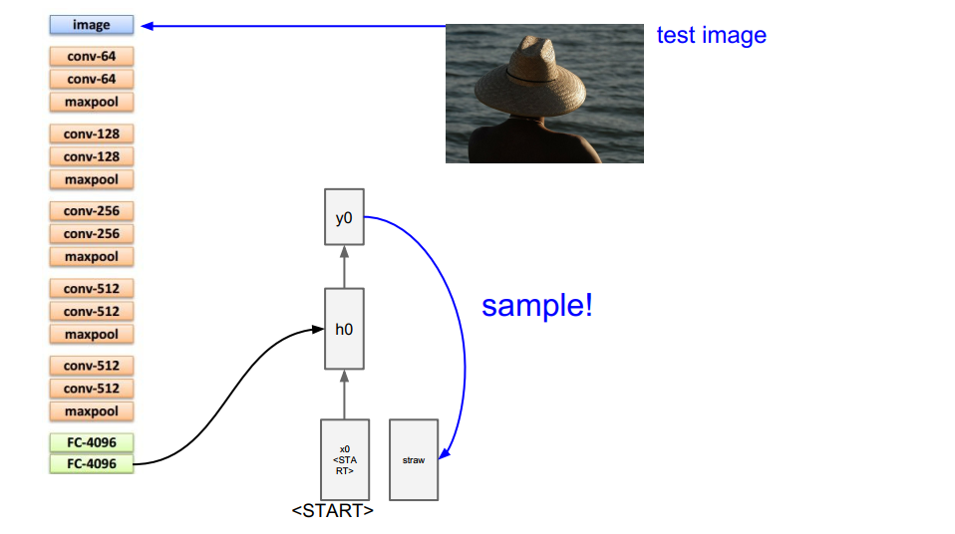

Slide 26
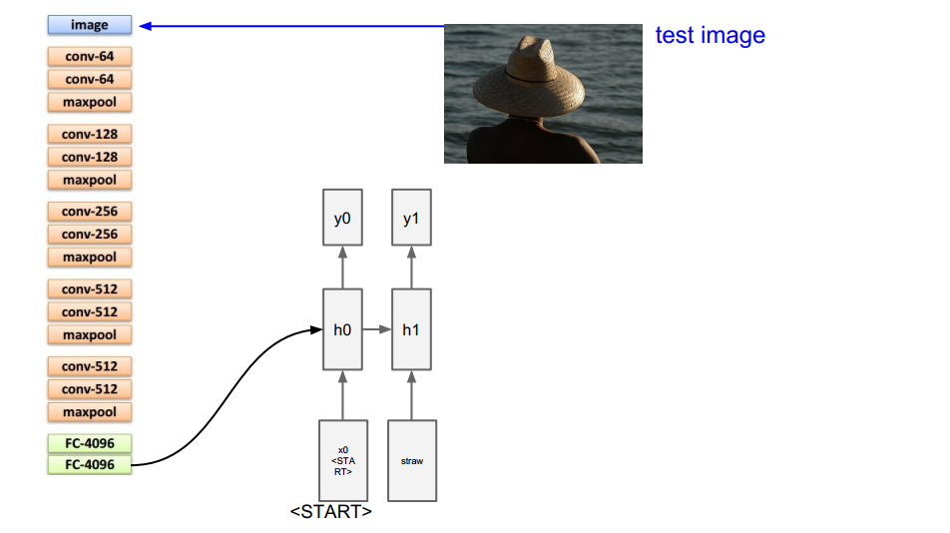

Slide 27
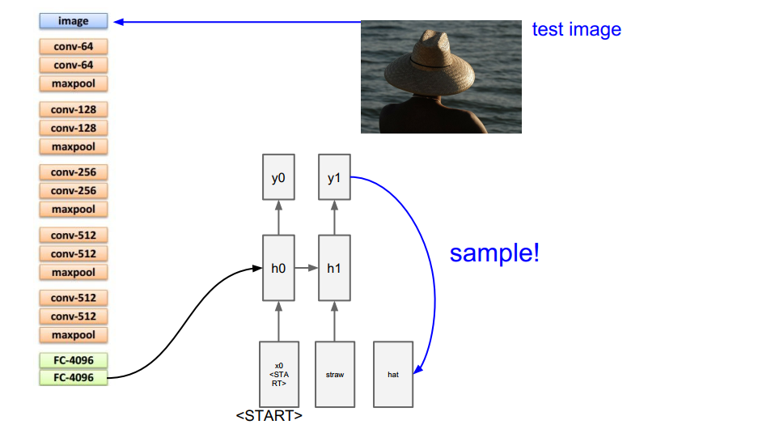

Slide 28
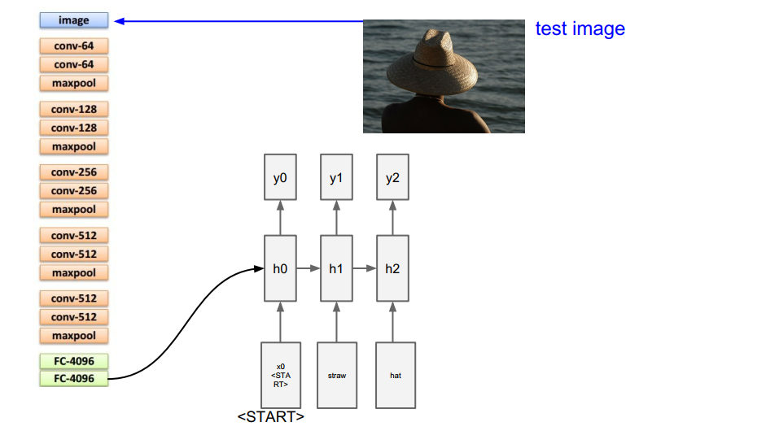

Slide 29
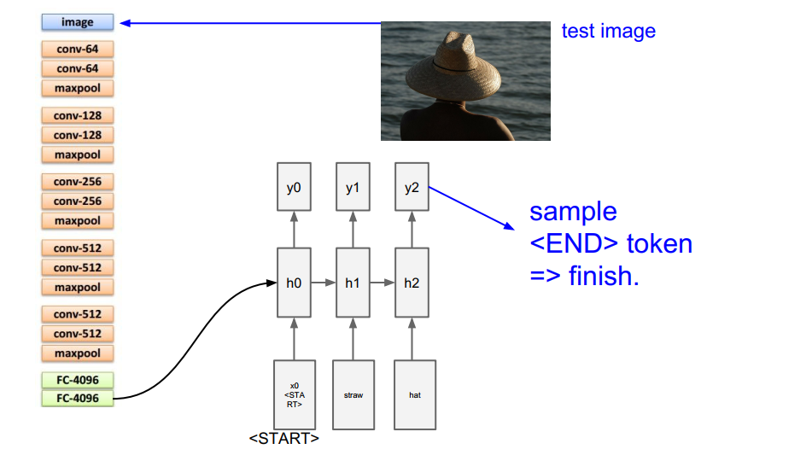

Slide 30
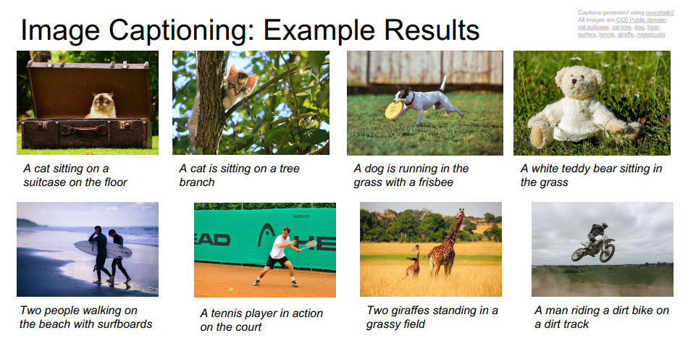

Slide 31
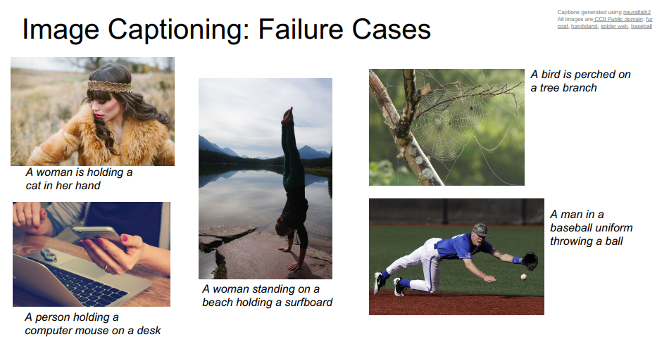

Slide 32
Reinforcement Learning

Slide 33
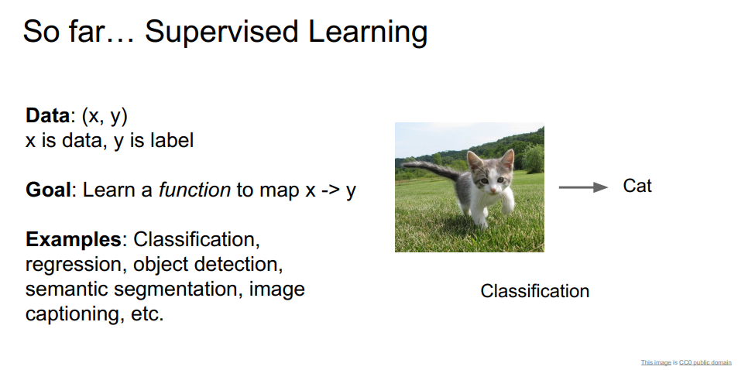

Slide 34
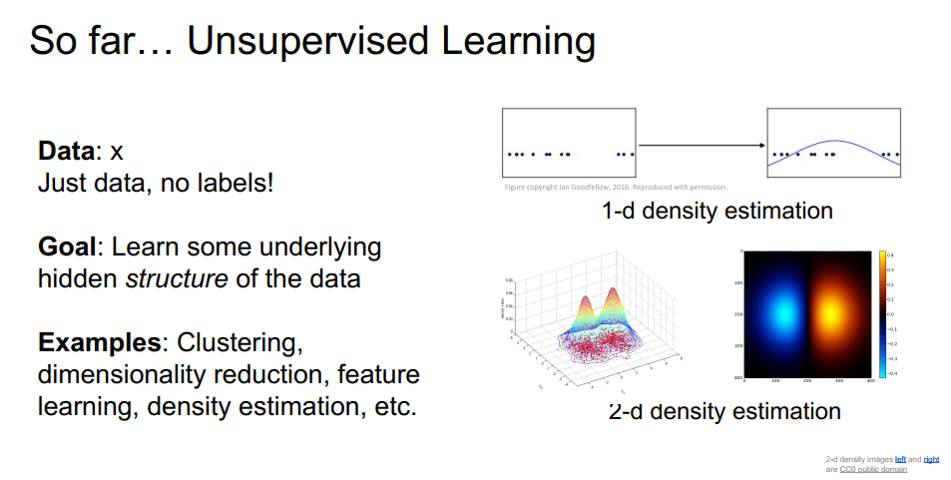

Slide 35
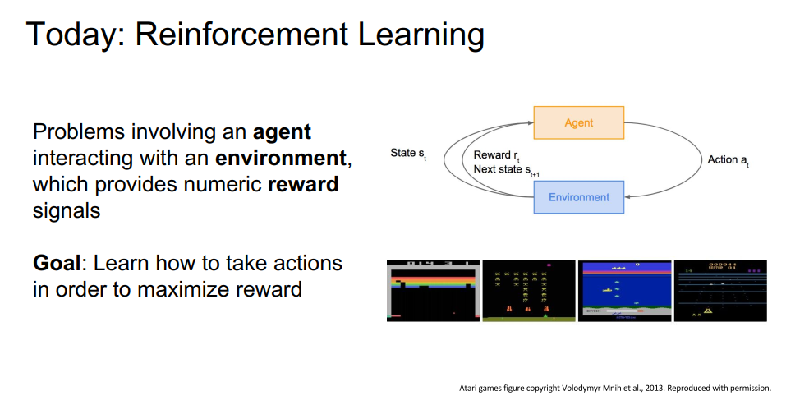
Reinforcement Learning

Slide 36
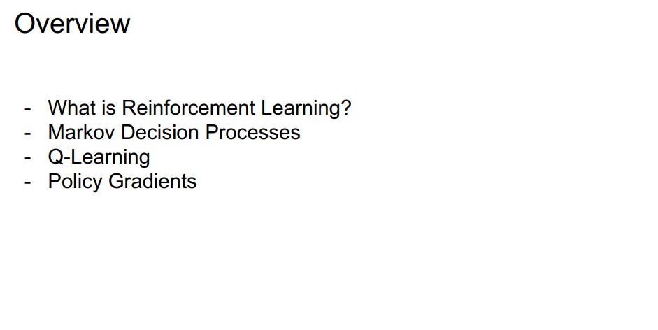

Slide 37
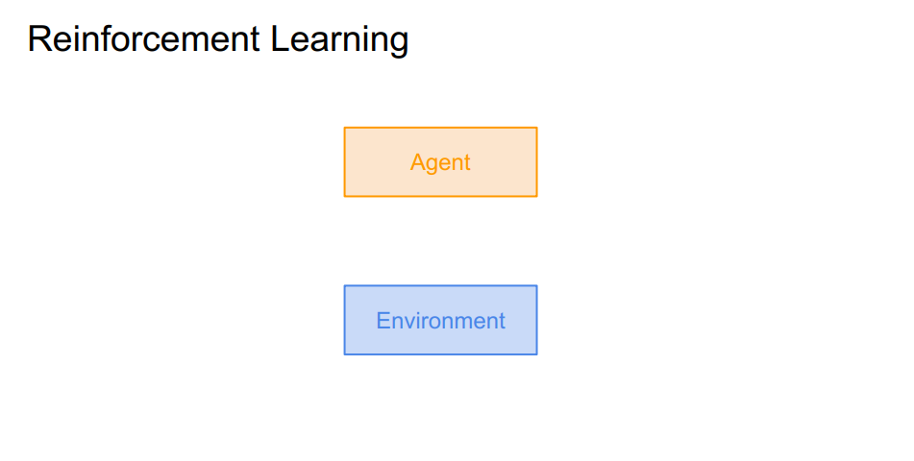

Slide 38
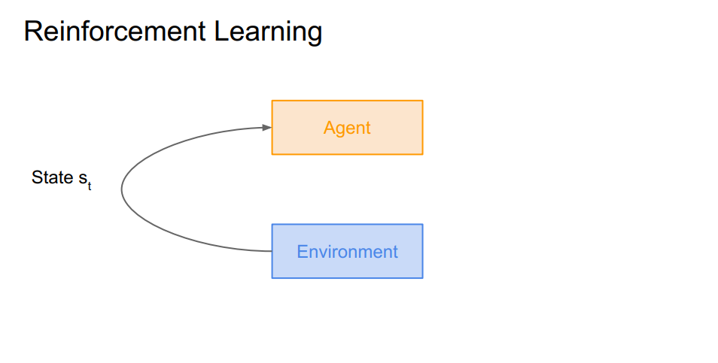

Slide 39
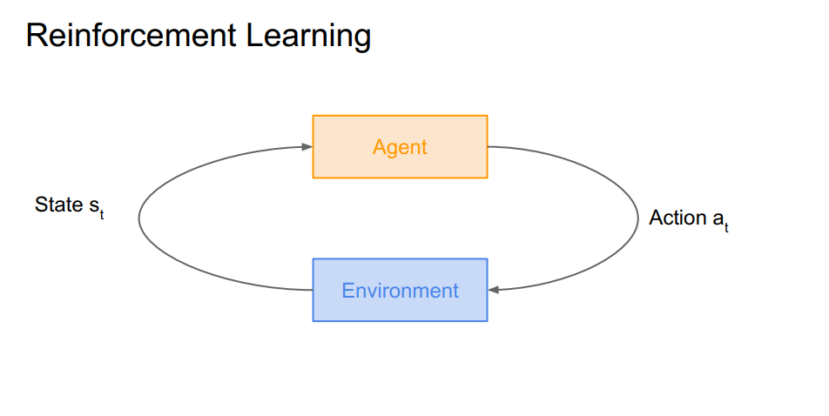

Slide 40
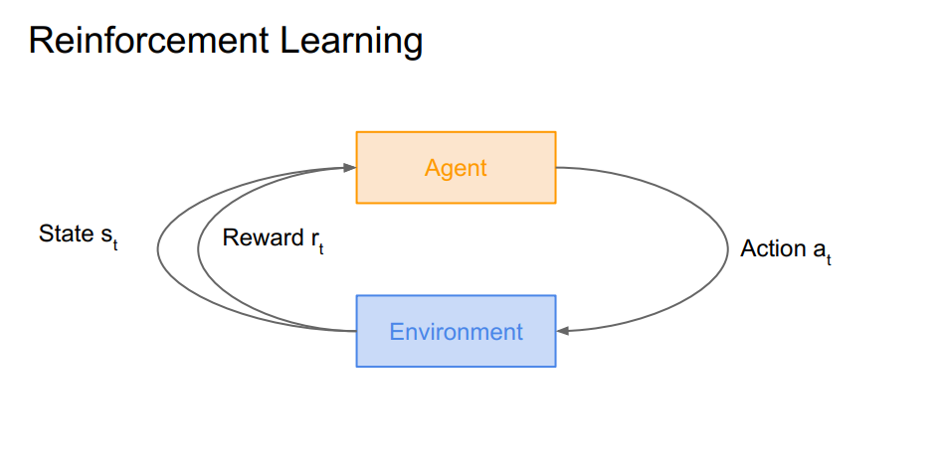

Slide 41
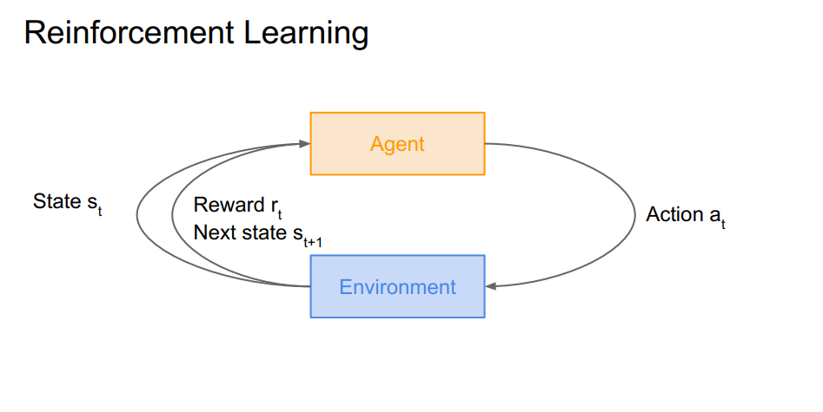

Slide 42
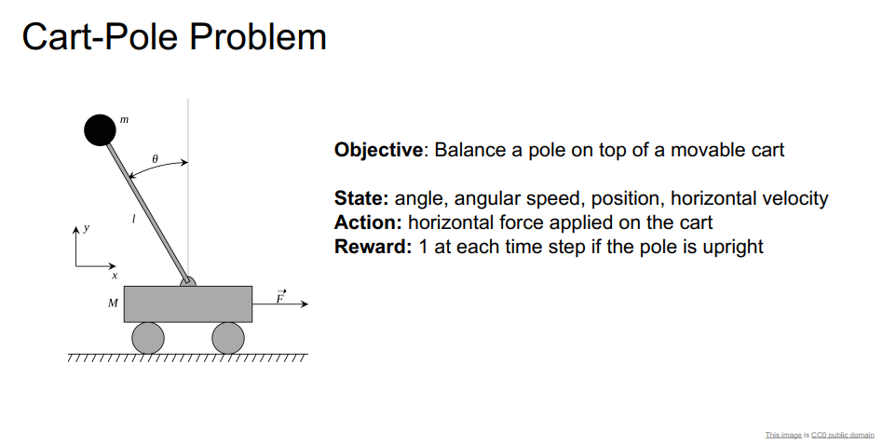

Slide 43
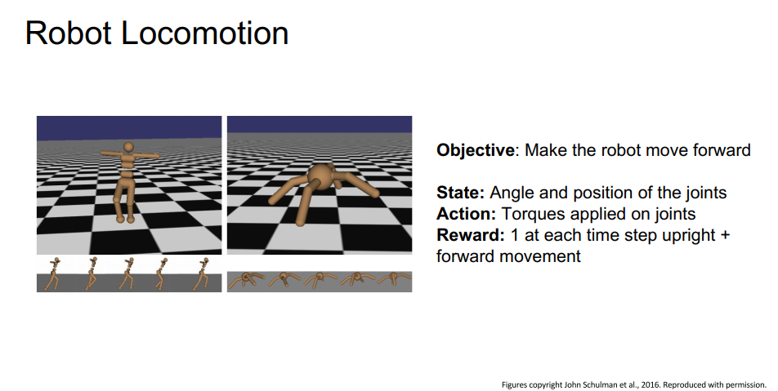

Slide 44
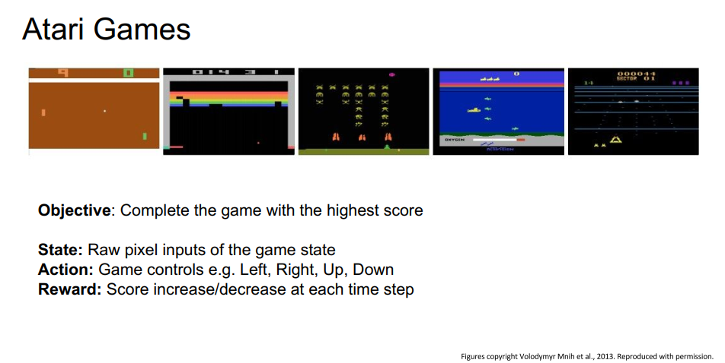

Slide 45
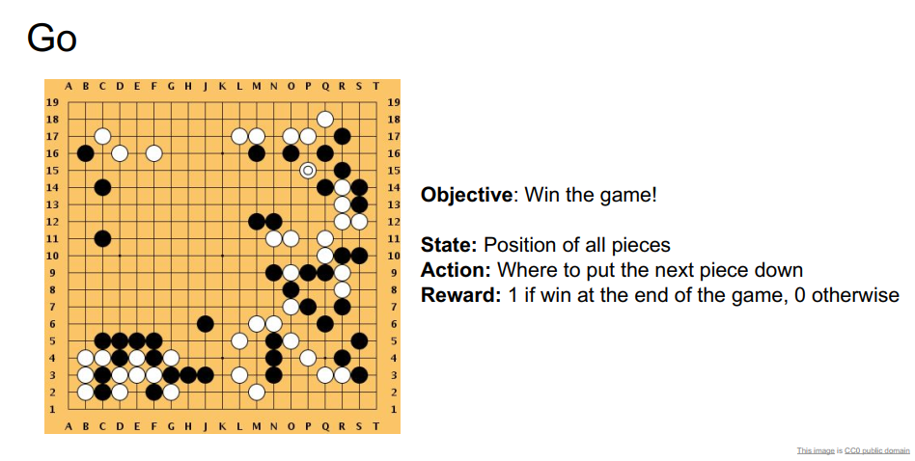

Slide 46
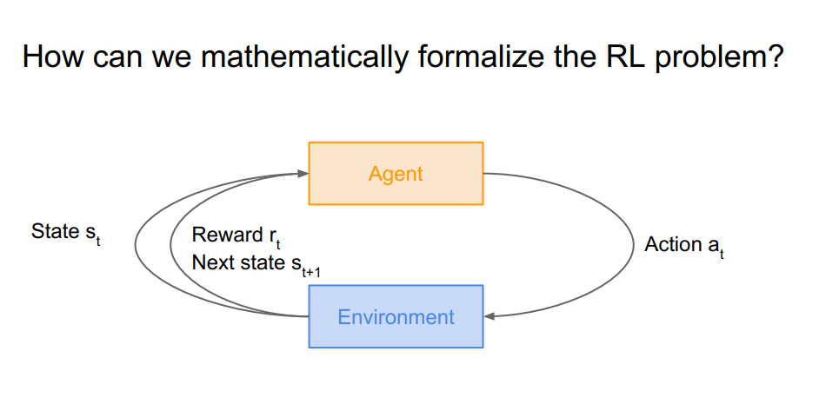

Slide 47
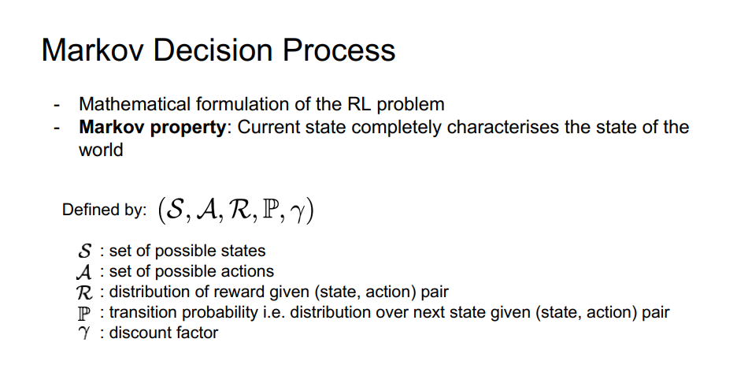

Slide 48
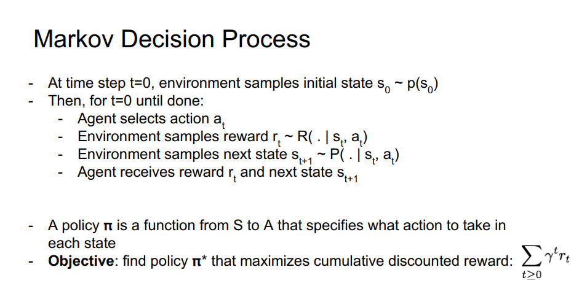

Slide 49
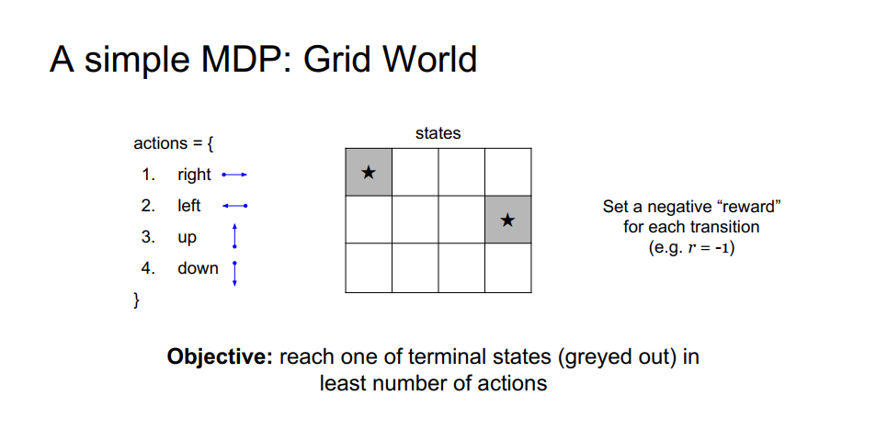

Slide 50
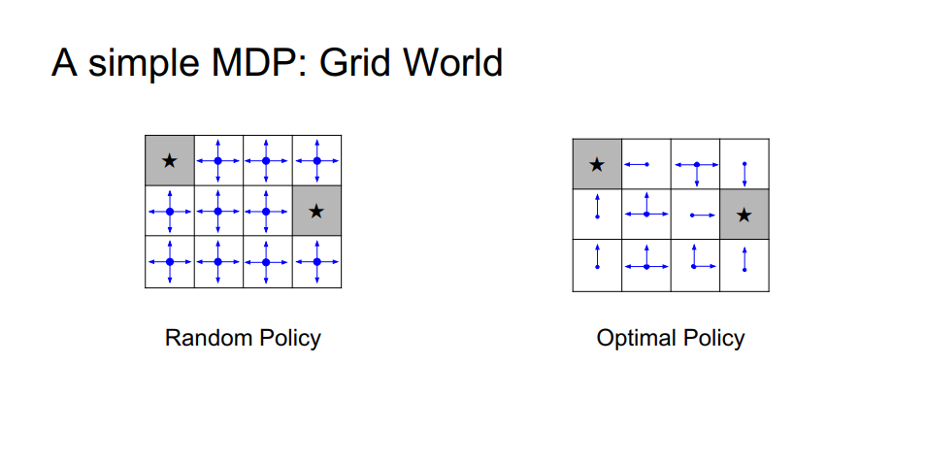

Slide 51
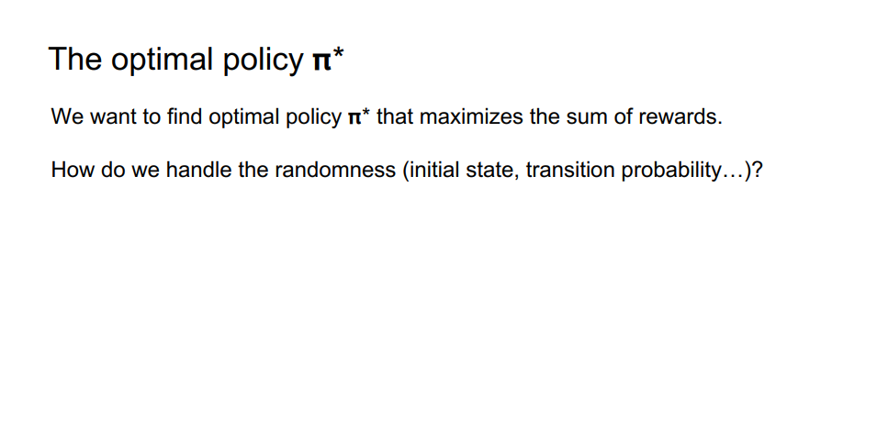

Slide 52


Slide 53


Slide 54


Slide 55


Slide 56


Slide 57


Slide 58


Slide 59


Slide 60


Slide 61


Slide 62


Slide 63


Slide 64


Slide 65


Slide 66


Slide 67


Slide 68


Slide 69


Slide 70


Slide 71



Slide 72


Slide 73


Slide 74


Slide 75


Slide 76


Slide 77


Slide 78



Slide 79


The second modification to online Q-learning aimed at further improving the stability
Use a separate network for generating the targets $y_{j}$ in the Q-learning update
Every C updates we clone the network Q to obtain a target network $\hat{Q}$ and use $\hat{Q}$ for generating the Q-learning targets $y_{j}$ for the following C updates to Q
This modification makes the algorithm more stable compared to standard online Q-Learning, where an update that increases Q($s_{t}$, $a_{t}$) often also increases Q($s_{t+1}$, $a_{t}$) for all $a$ and hence also increases $y_{j}$, possibly leading to oscillations or divergence of the policy.
Generating the targets using an older set of parameters adds a delay between the time an update to Q is made and the time the update affects the targets $y_{j}$, making divergence or oscillations much more unlikely.

Slide 80










Initial target and value networks
Copy the weights of network Q to target network $\hat{Q}$

Slide 82
Next Time:
Policy Gradients

